Slide 1
REAL TIME VIDEO CAPTIONING
USING DEEP LEARNING
SUBJECT: COMPUTER VISION(IT813)
PRESENTED BY:
AMRIT MOHAPATRA(222IT004)
NEERAJ KUMAWAT(222IT023)

Slide 2
VIDEO CAPTIONING
Video Captioning is the process of generating captions that describe the events of a video automatically.

Slide 3
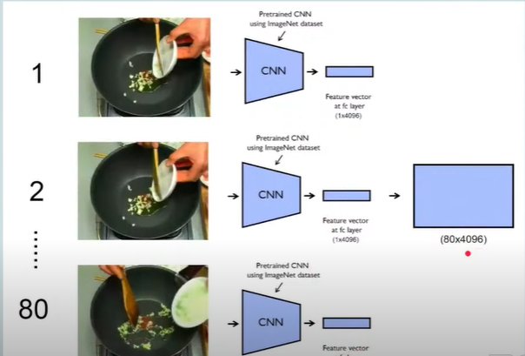
VGG -16 MODEL
Since the length of videos is different, the
number of frames extracted is also going to
be different. So for the sake of simplicity,
only 80 frames are taken from each video.
Each of the 80 frames is passed through a
pre-trained VGG16 and 4096 features are
extracted from each frame. These features
are stacked to form an (80, 4096) shaped
array. 80 is the number of frames and 4096
is the number of extracted features from each
frame.

Slide 4
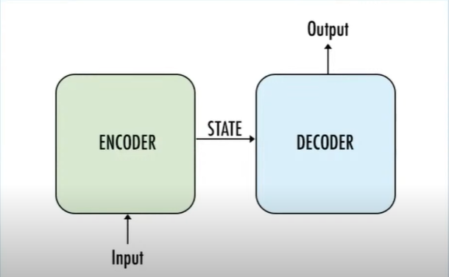
Encoder Decoder
We will be using Encoder Decoder model to generate text. Encoder Decoder model is used when we give one form of input and get other form of output.

Slide 5
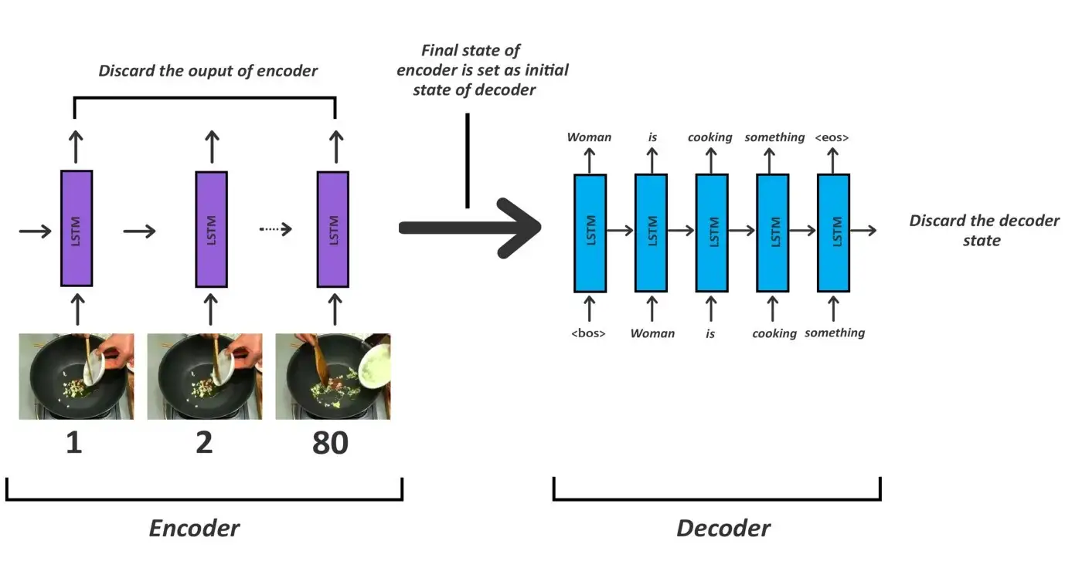
LSTM MODEL
Video is a sequence of images
so we will use sequence model
like RNN, LSTM etc.
Encoder feeds features of
images we will be using LSTM.
Decoder is also a part which is
used to generate captions,
Captions are again sequence of
words so for captions also
we will be using LSTM.

Slide 6
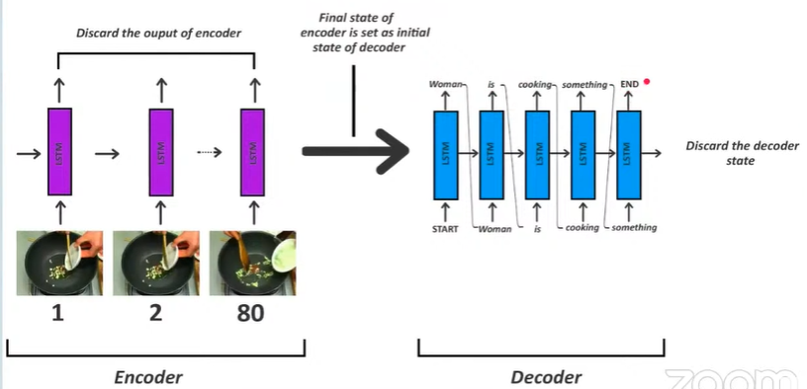
INFERENCE MODEL
Training model and inference
model for encoder decoder
model is different, we need
to save both of them differently.
Encoder remains same but for
the Decoder part, there are
some changes. Unlike in the training
part we don't have any captions so
the output from previous cell will act
as input to the next cell.

Slide 7
METHODOLOGY
Feature Extraction: We are extracting the features of images from video.Every video contains 80 frames.
After extracting the frames ,we are passing that frames into LSTM model to get the output.
Dataset: This project is build on the MSVD dataset. It contains 1450 training videos and 100 testing videos.

Slide 8
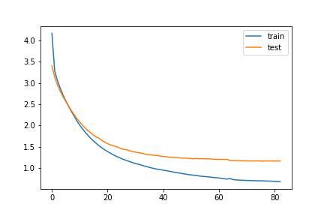
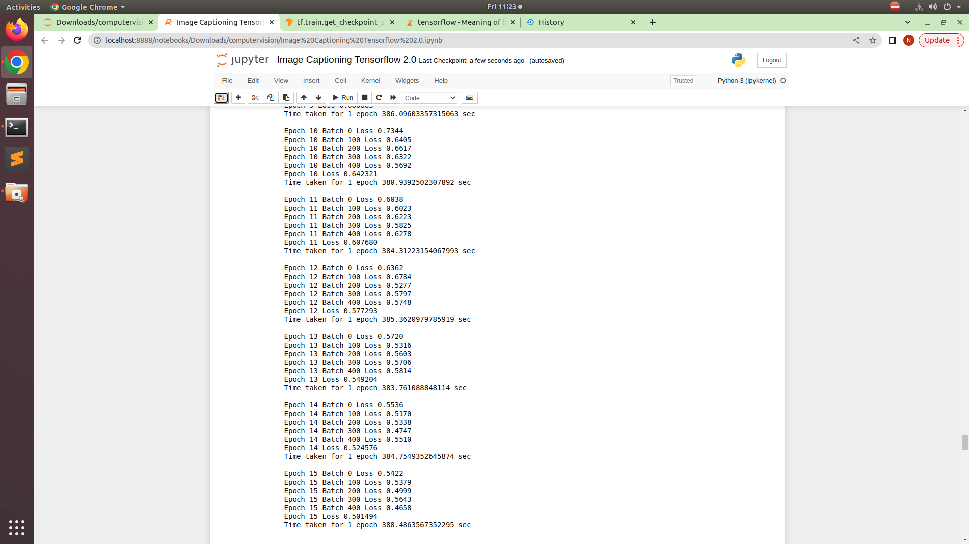
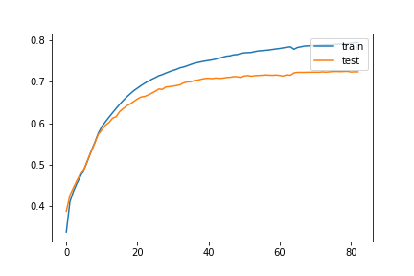
TRAINING OF MODEL

Slide 9
THANK YOU

